Slide 1
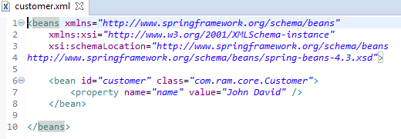
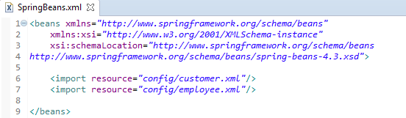
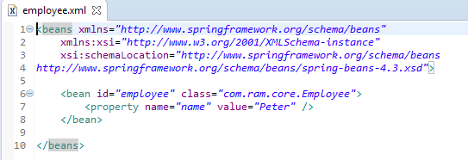
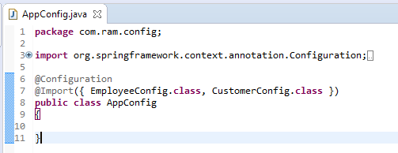
How to Split a large Spring XML bean files
We can split a large Spring XML bean files into multiple small files, group by module or category, to make things more maintainable and modular.

Slide 2
How to Split a large Spring XML bean files
Project dir structure

